Slide 1
NN Through Simple Example

Slide 2
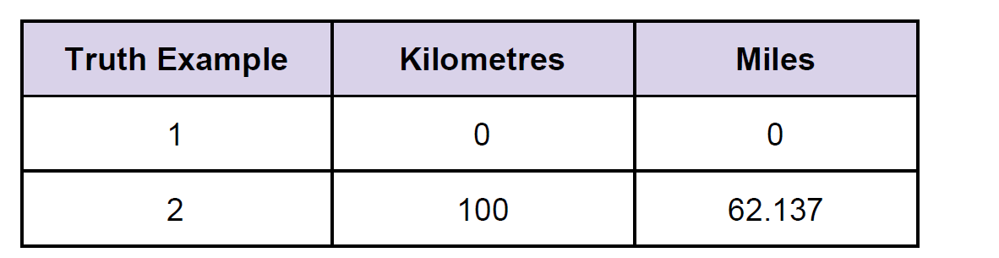
A Simple Predicting Machine
How to predict without formula
Relationship is linear
Or if we double the number in miles, the same distance in kilometers is also doubled
OR miles = km * c but c? Randomly choose c =0.5
answer should be 62.137
We get error
error = truth calculated
= 62.137 - 50
= 12.137

Slide 3
How much we nudge the value of c?
Correction is a fraction of the error.
Big error means a bigger correction is needed, and a tiny error means the teeniest of nudges to c .
This is the very core process of learning in a
neural network to train the machine to get better and better at giving the right answer
This process is iterative, and it means repeatedly improving an answer bit by bit
miles = km * c
Increase c to c=0.6
Error = 2.137
Increase to 0.7 c=0.7
Error = -7.863(overshot)
Now make it between 0.6 and 0.7
0.61 c= 0.61
Error = 1.137

Slide 4
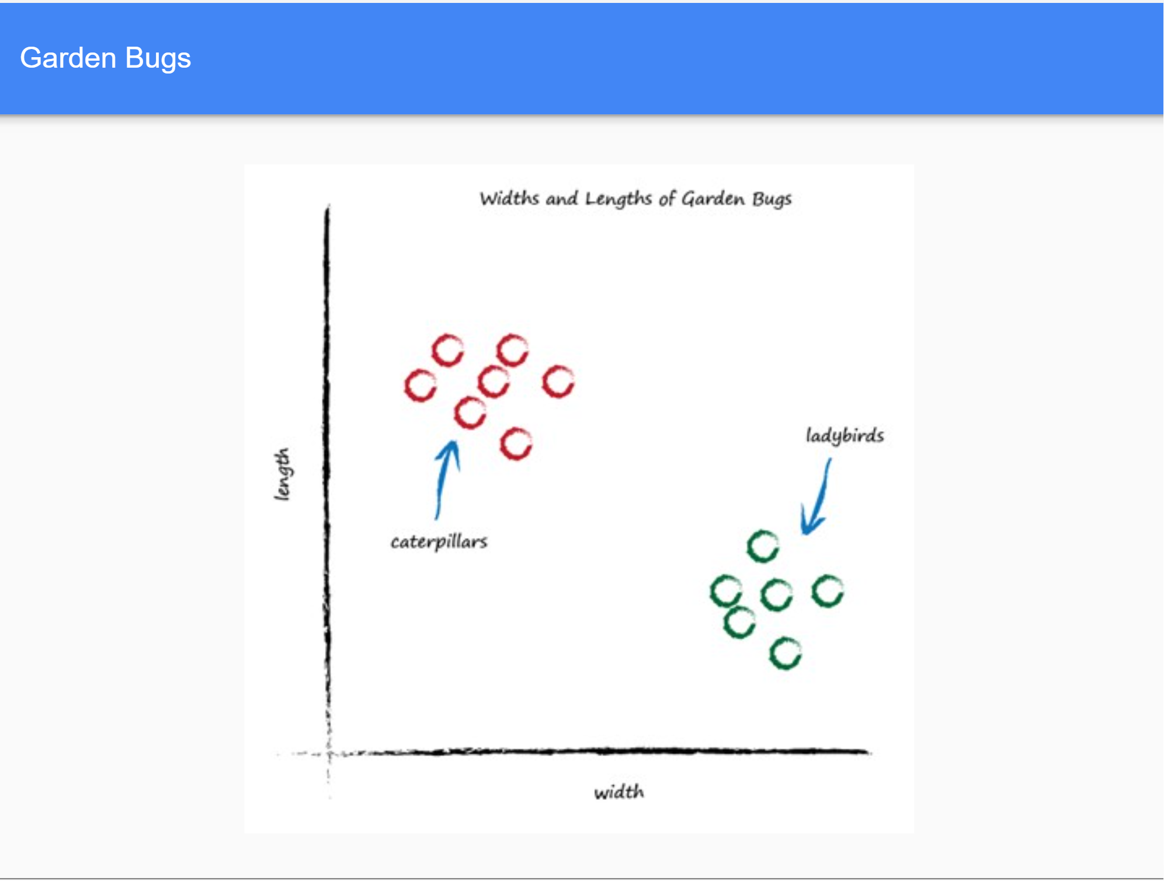
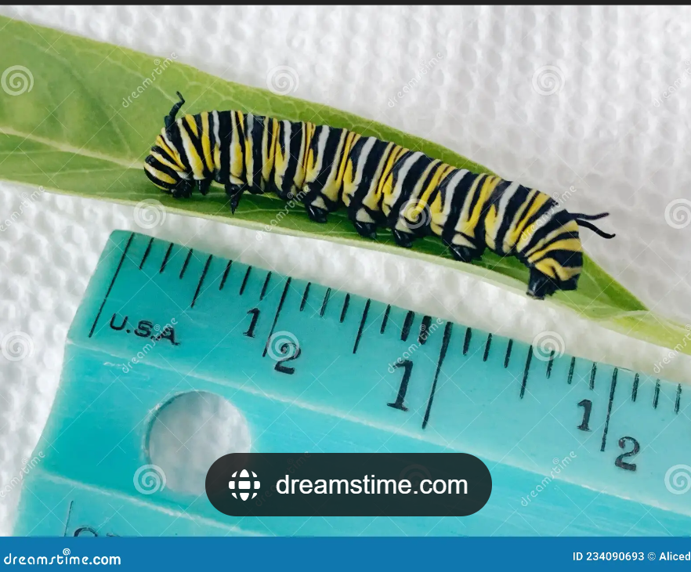

Training a Classifier for Garden Bug

Slide 5
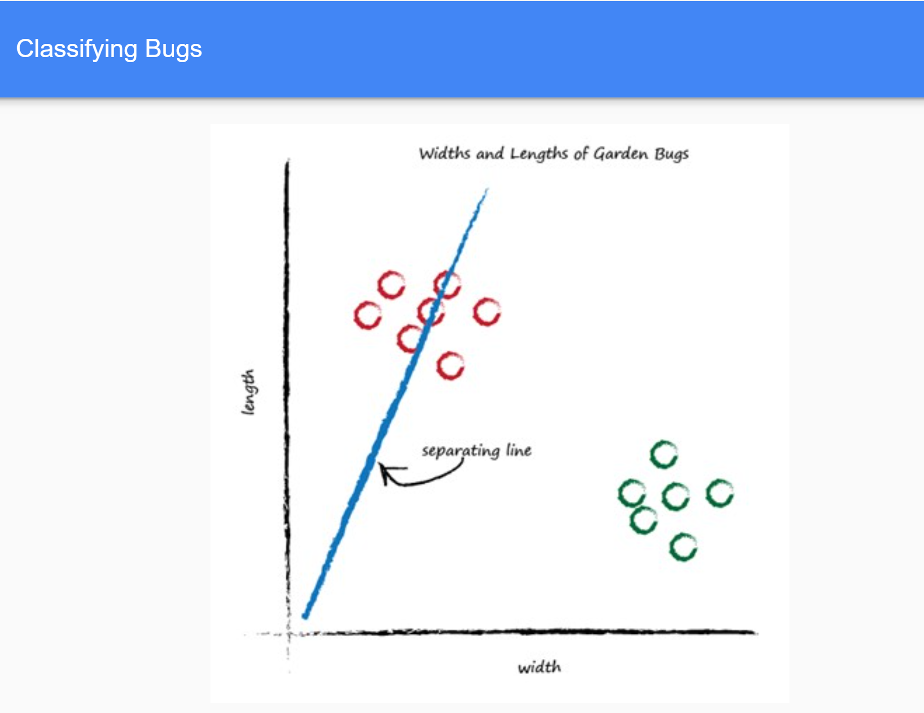

Slide 6
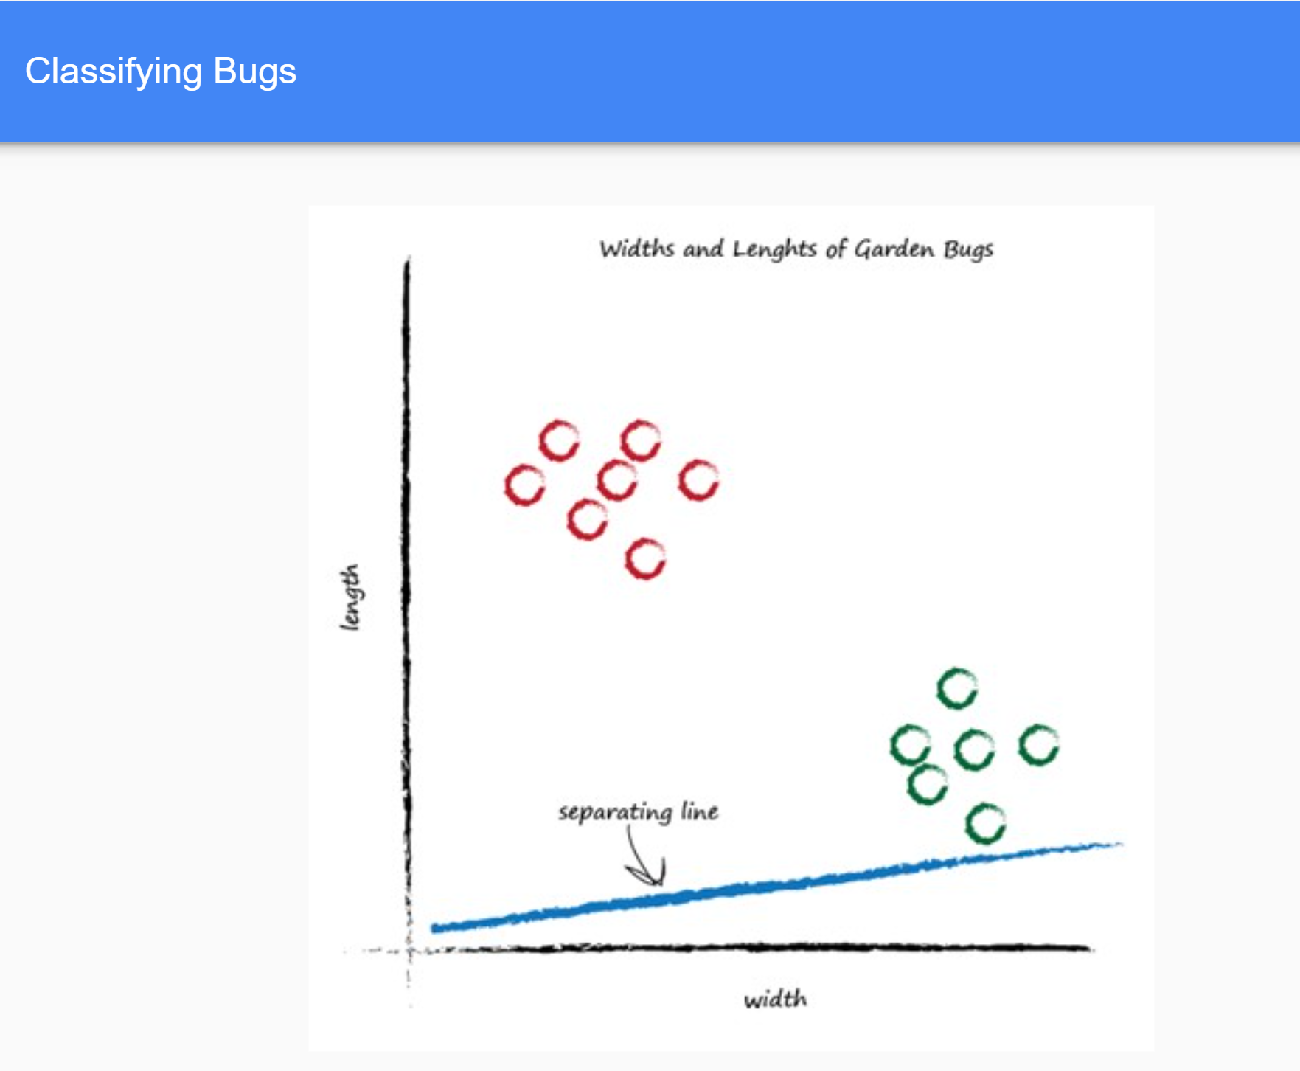

Slide 7
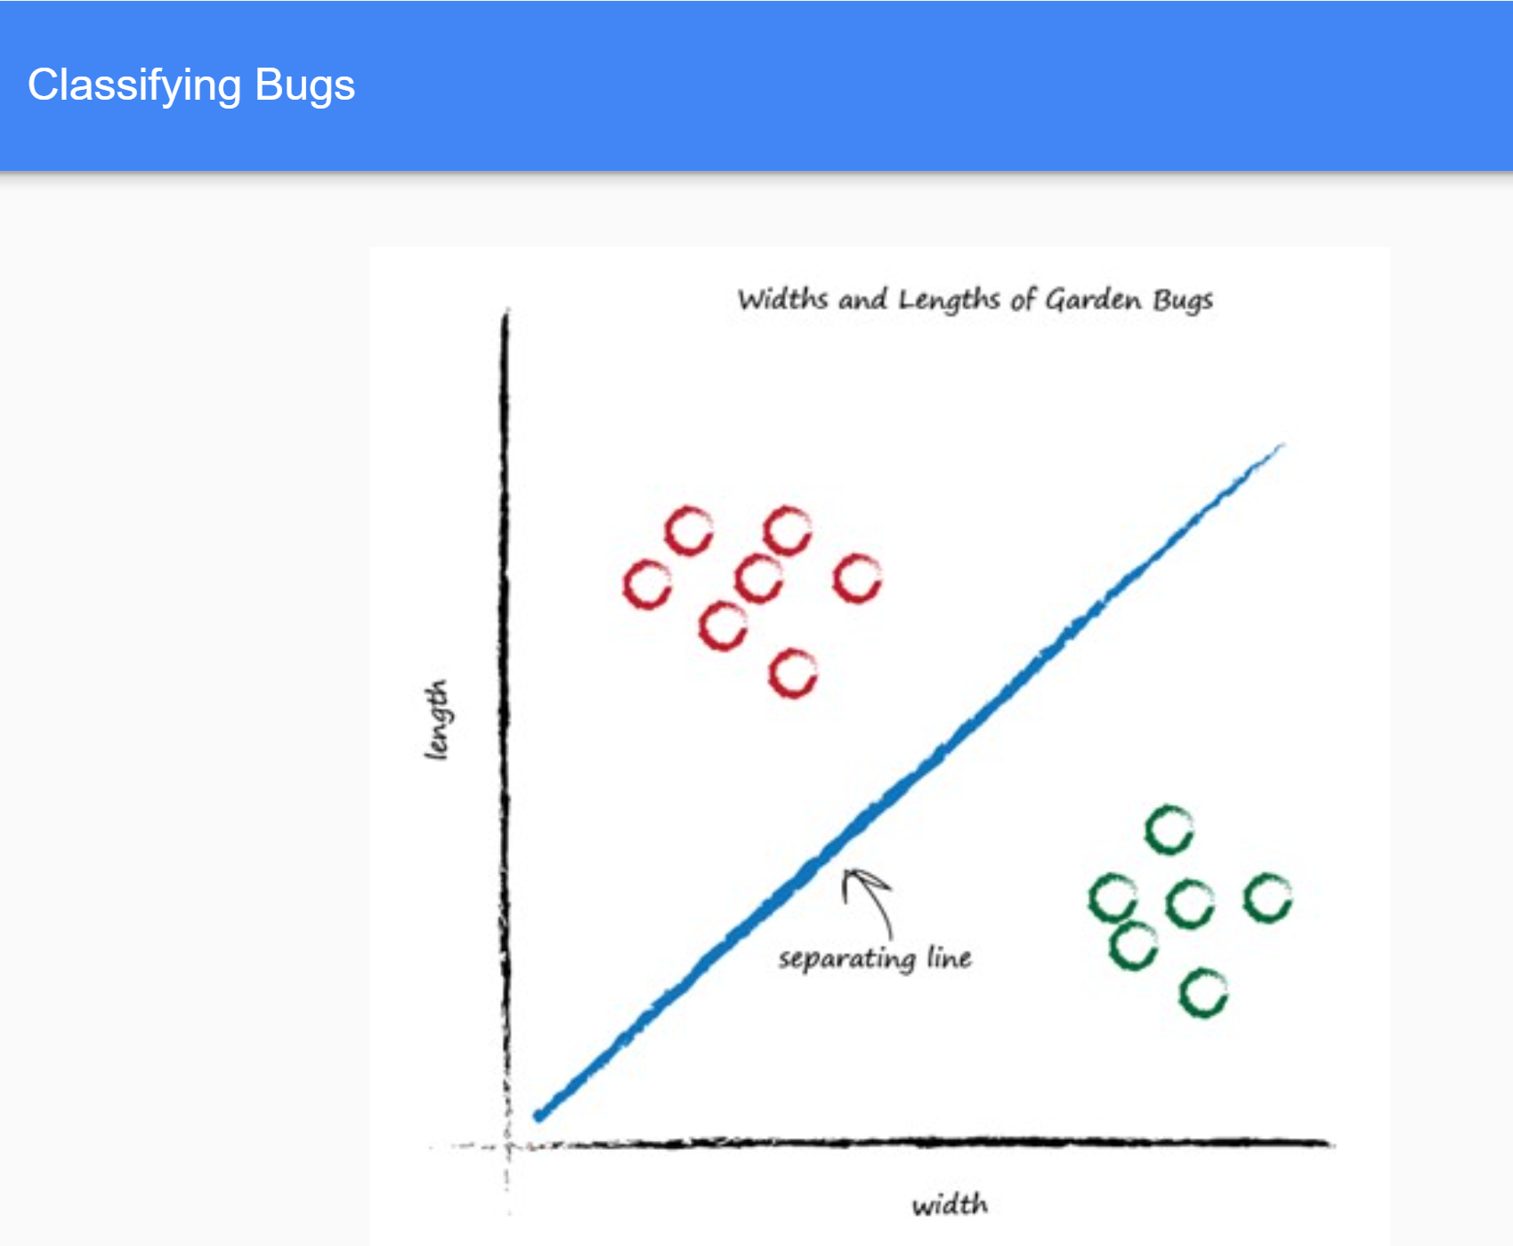

Slide 8
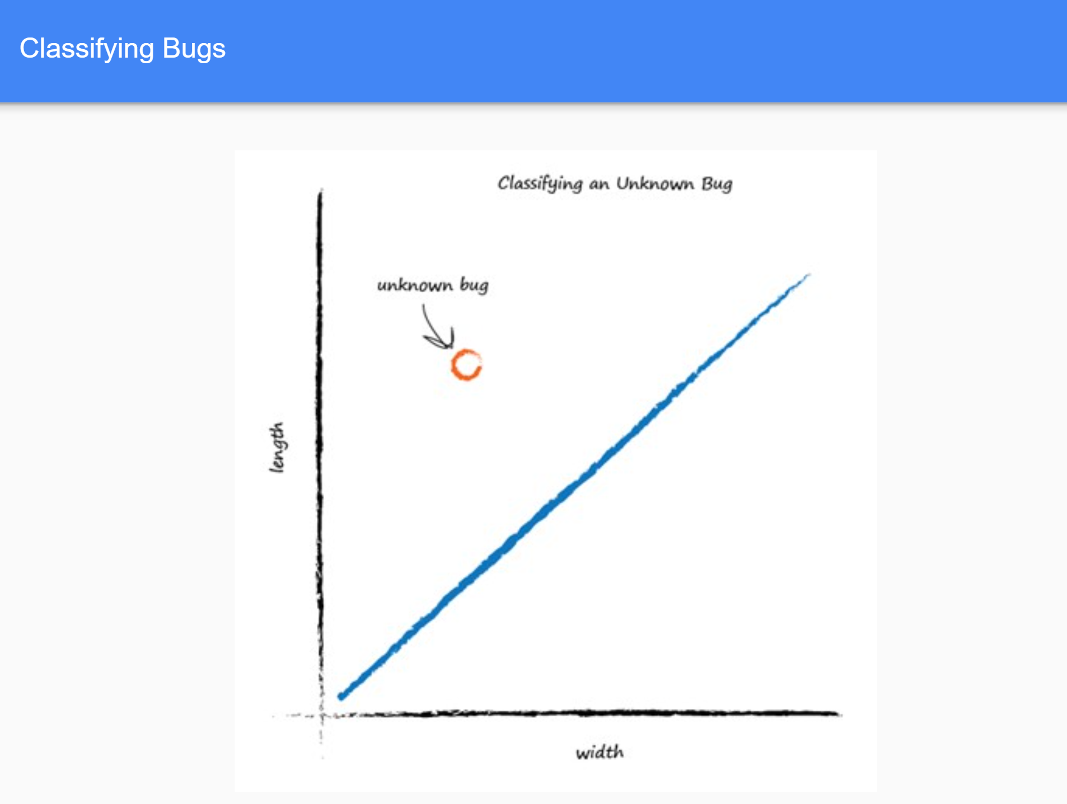

Slide 9
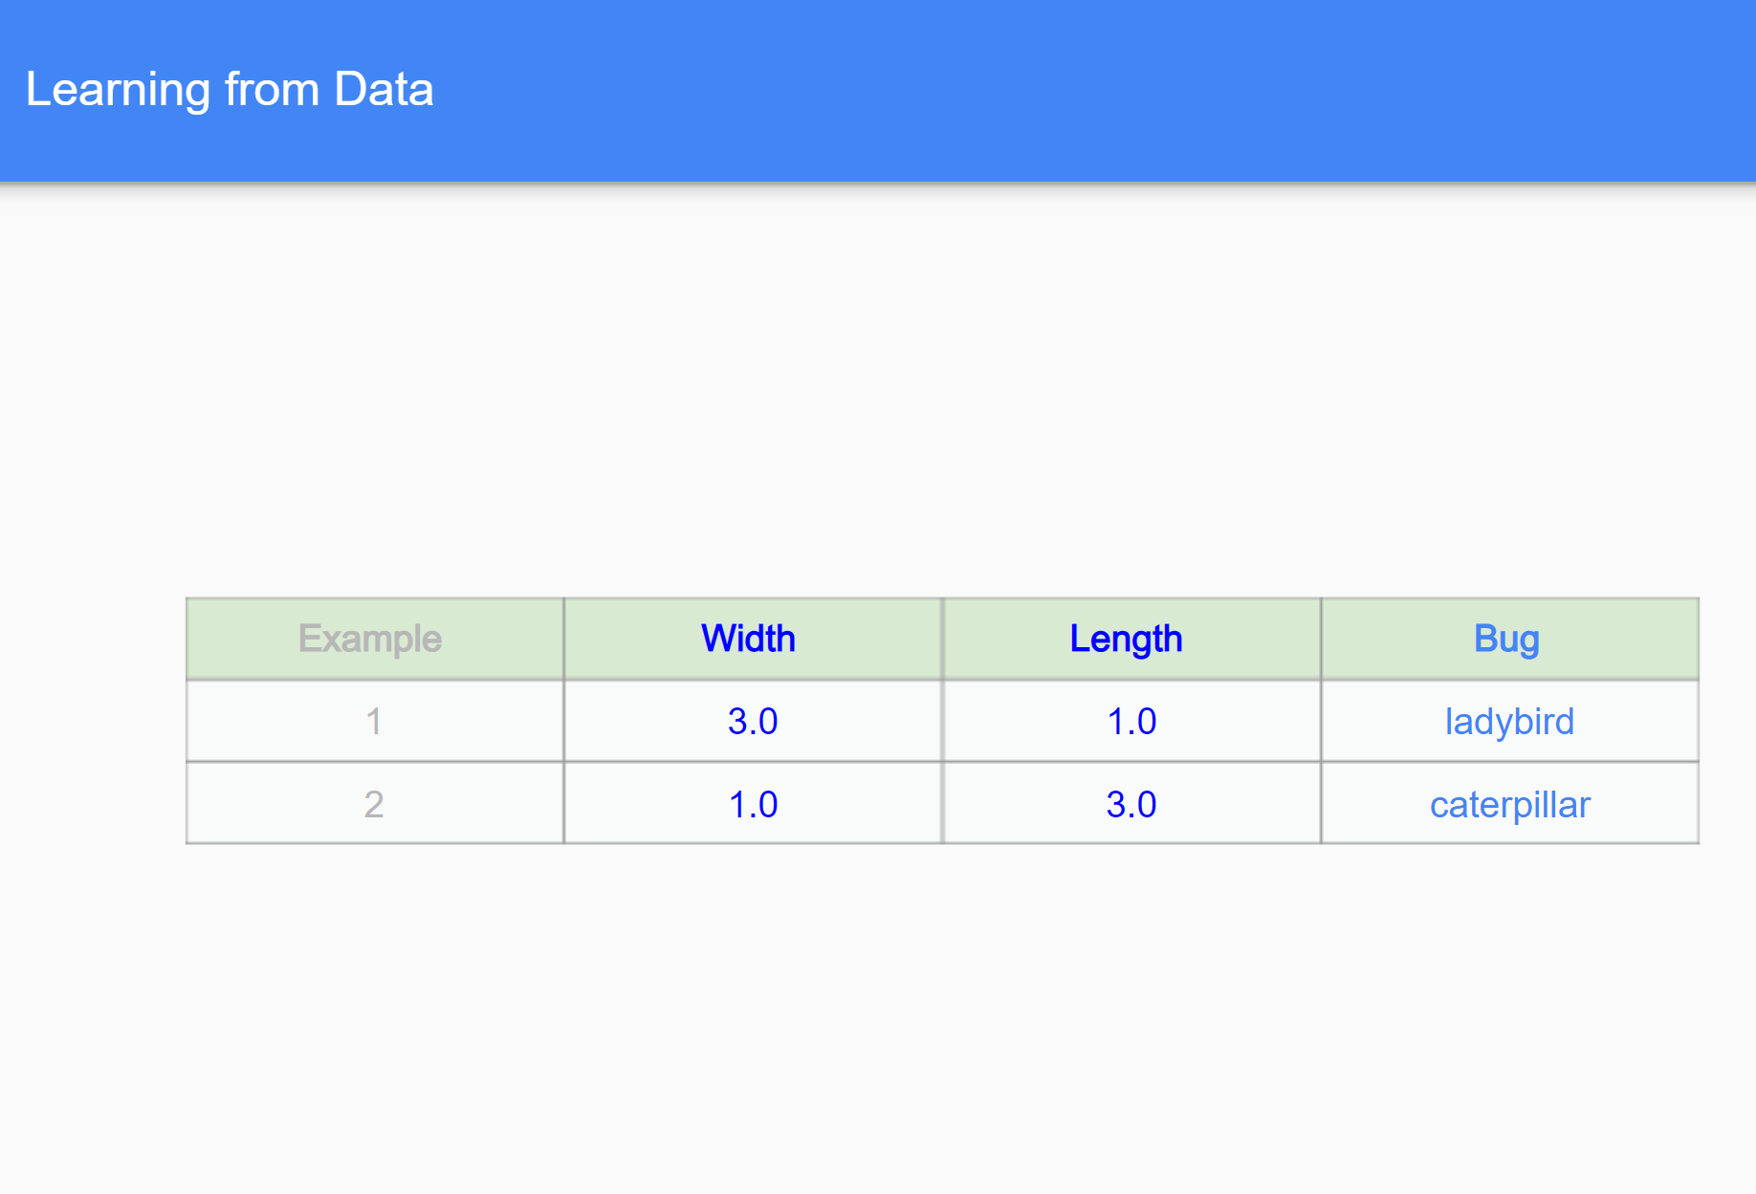
Training Dataset
Examples of truth used to teach a predictor, or a classifier are called the training data .

Slide 10
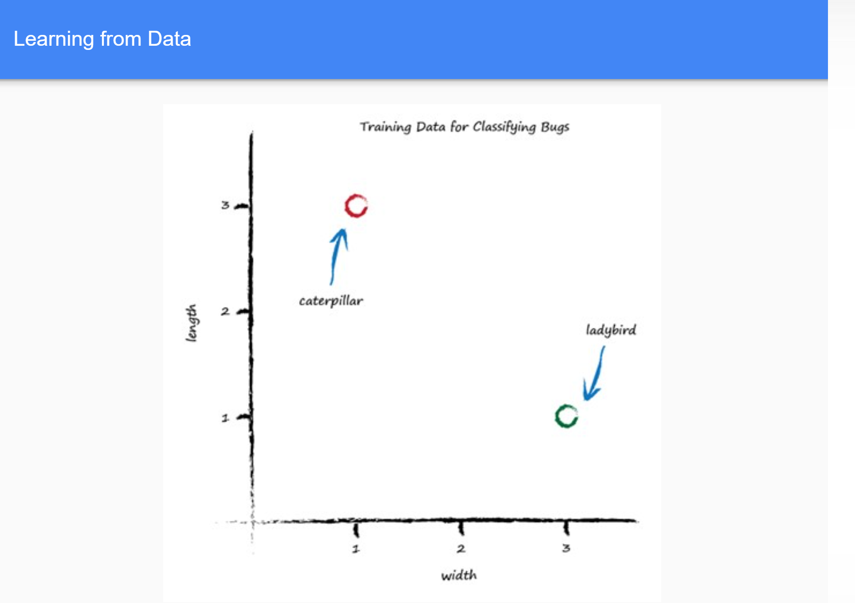
A linear function as dividing line is straight Line so we can say that y = Ax
Why the names y and x instead of length and width as done in km and miles example:
Because the line is not a predictor here. It doesn’t convert width to length, but it is a dividing line, a classifier.
The parameter A controls the slope of the line.
The larger A is the larger the slope.

Slide 11
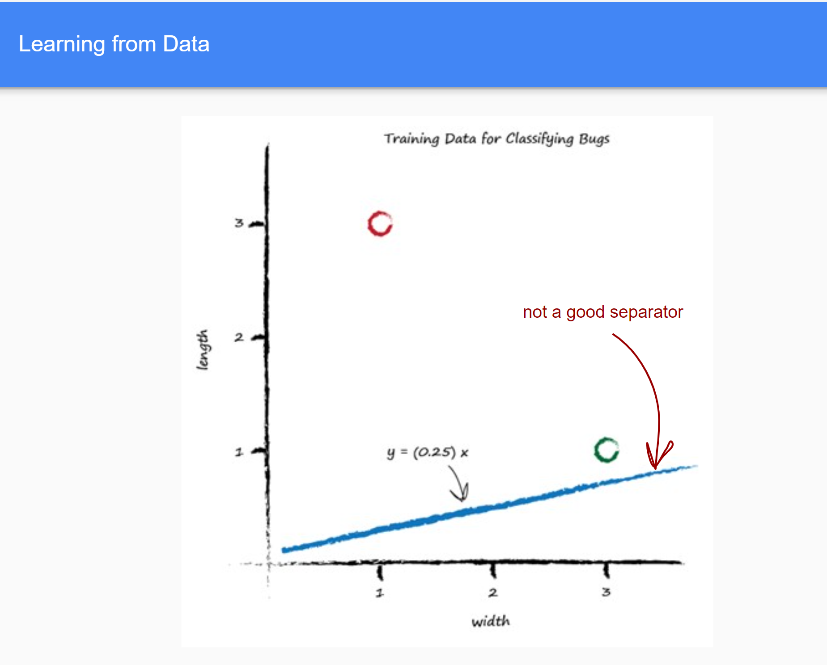
How Training Data works
A is 0.25 to get started. The dividing line is y = 0.25x
y = Ax
How to adjust line:
Step of repeated instructions or an algorithm.
FOR EXAMPLE,
The width is 3.0 and length is 1.0 for a ladybird. If we
tested the y = Ax function with this example where x is 3.0,
y = (0.25) * (3.0) = 0.75
The parameter A = 0.25, (initial randomly chosen)
So for a bug of width 3.0, the length should be 0.75.
that’s too small
As the training data example tells us it must be a length of 1.0
There is an error (this error is used to inform how to adjust the parameter A .) BACK

Slide 12
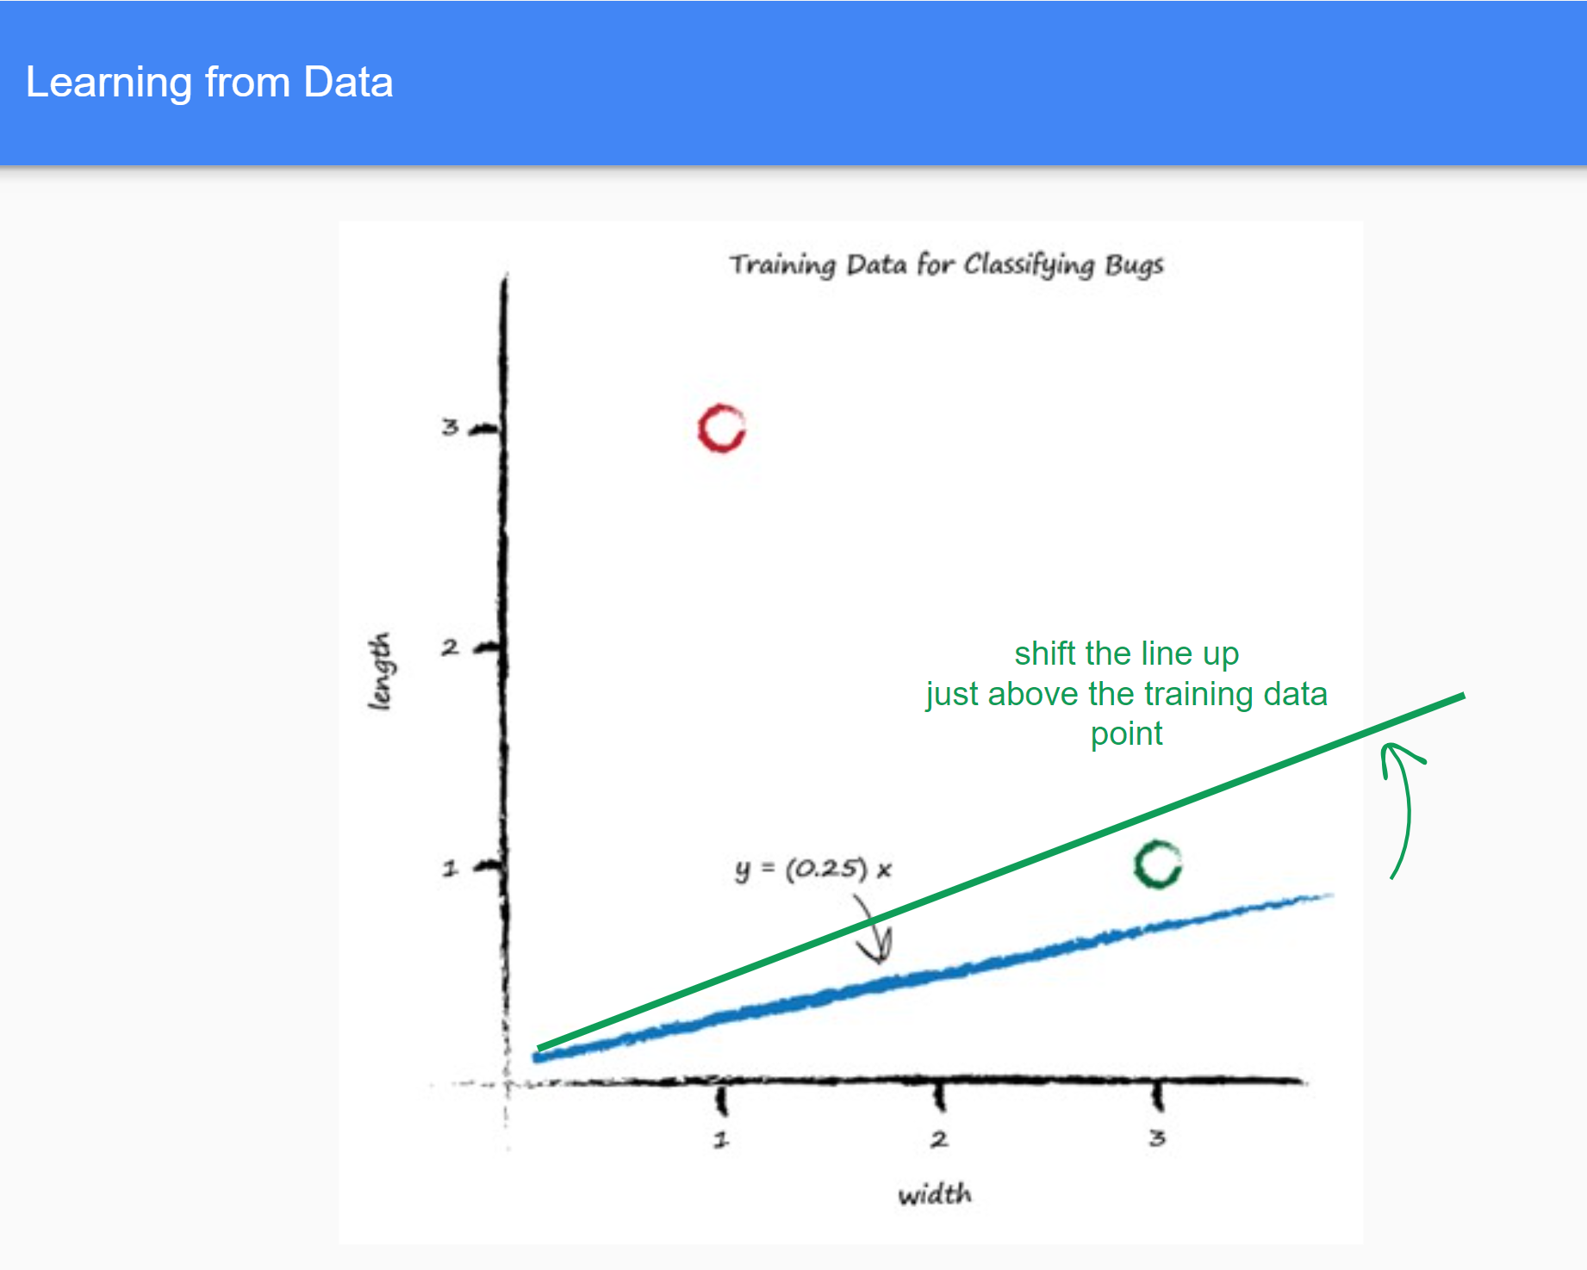
This line seems to be a predictor of a bug’s length given its width
The line is required to be a dividing line between ladybirds
and caterpillars, not a predictor of a bug’s length given
its width.
Another Example y = 1.1 when x = 3.0
Error = (desired target – actual output)
E = 1.1 - 0.75 = 0.35

Slide 13
Visual Representation of Error = (desired target – actual output)

Slide 14
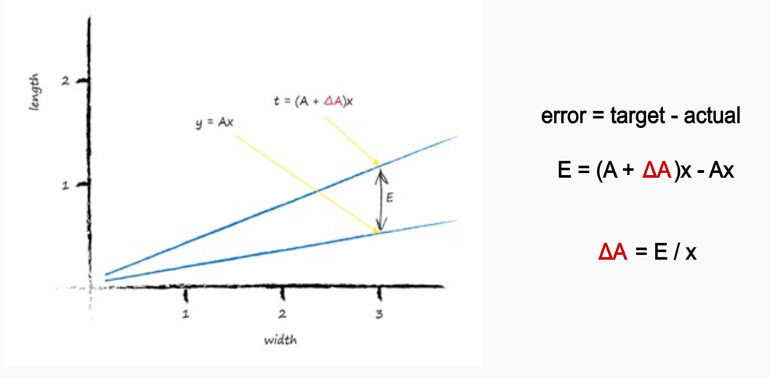
Updating Parameter
E to guide us to a better refined parameter A but how?
the linear function for the classifier: Y = Ax
Consider correct desired value for target is t = (A+ΔA)x
Where Δ means small change or delta, i.e. required for adjusting A
Error = (desired target – actual output)
t - y = (A + ΔA)x Ax
E = t – y = Ax + (ΔA)x Ax
E = (ΔA)x
How much to adjust A by to improve the slope of the line so it is a better classifier, being informed by the error E .
Therefore, visiting our example Back .

Slide 15
Updating Parameter
The error was 0.35 and the x was 3.0.
That gives Δ A = E / x as 0.35 / 3.0 = 0.1167.
So, to change the current A = 0.25 by 0.1167. That means the new improved value for A is
( A + Δ A ) which is 0.25 + 0.1167 = 0.3667.
Finally, the calculated value of y with this new A is 1.1
Another Example # 2 caterpillar
x =1.0 , y = 3.0 and we have updated value ( A + Δ A ) = 0.3667, so y = 0.3667 * 1.0 = 0.3667. but desired target is y = 3.0
Let’s set desired target value at 2.9. The error E is (2.9 0.3667) = 2.5333.
The Δ A is E / x which is 2.5333 / 1.0 = 2.5333. The newer A is 0.3667 + 2.5333 = 2.9

Slide 16
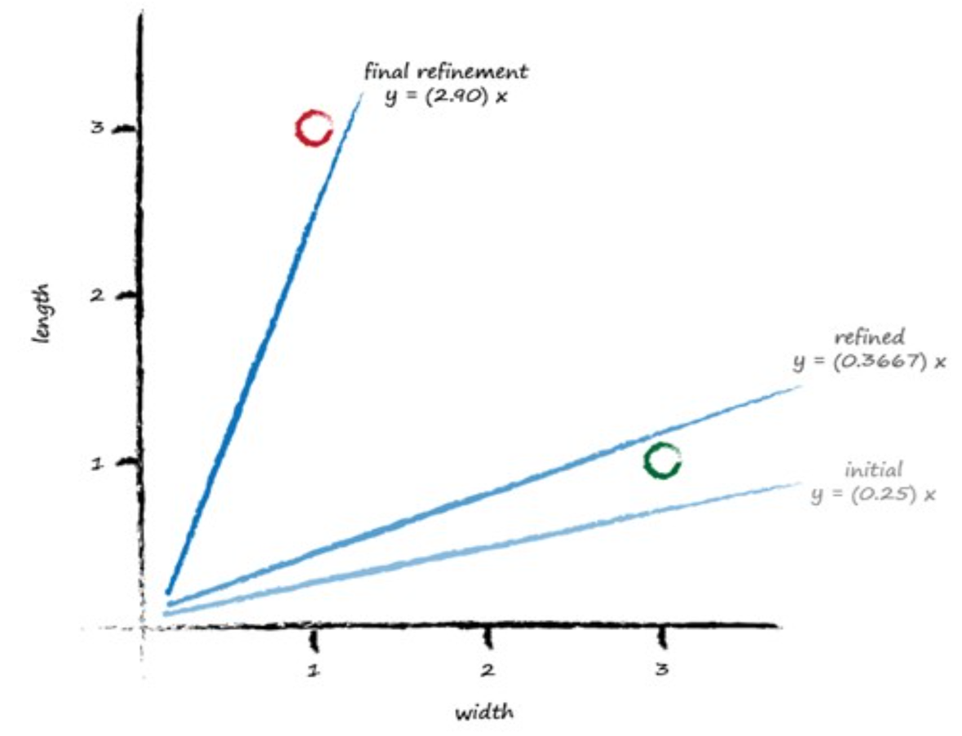
Error adjustment after 2nd training example
Error adjustment after 1st training example
Slope of line with randomly chosen value
If Updating for each training data example, the final update simply matches the last training example closely

Slide 17
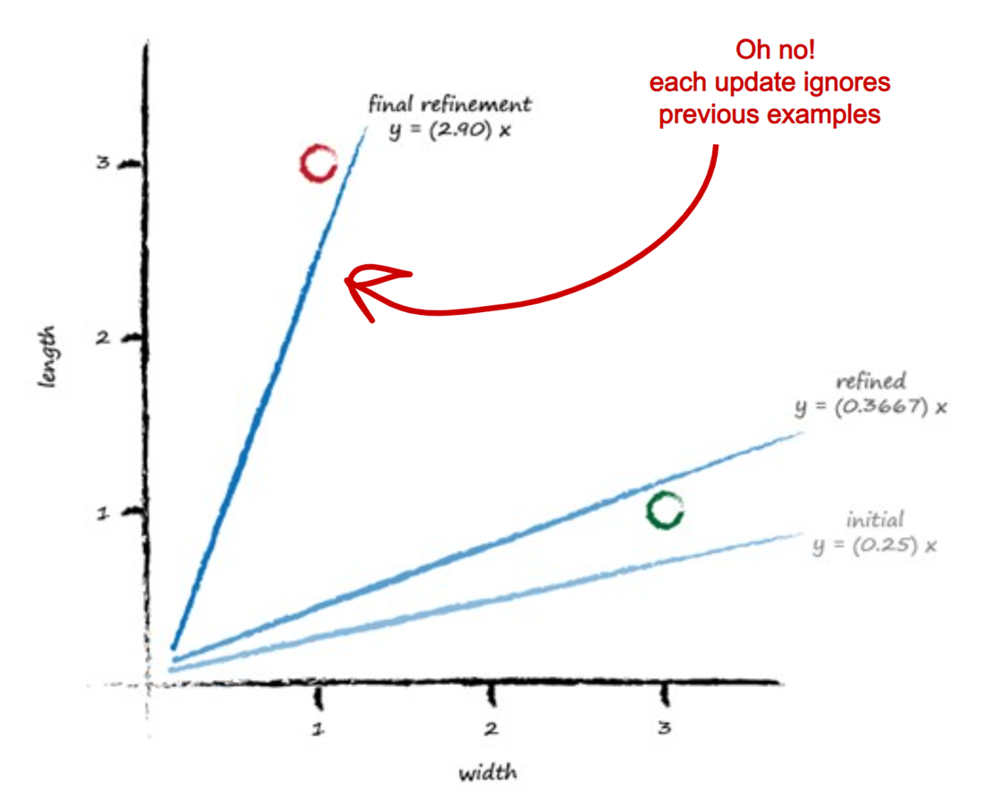
So, to keep in context all learning example, We do not take every change in A(Δ A) as whole but fraction or part of it.
This is term as moderation an important concept in ML.
This concept can also be observes in mile to KM example(changing parameter c by small amount).
ΔA = L (E / x )
Where L is moderation or learning rate.
If we take L = 0.5, only update half as much as would have done without moderation.

Slide 18
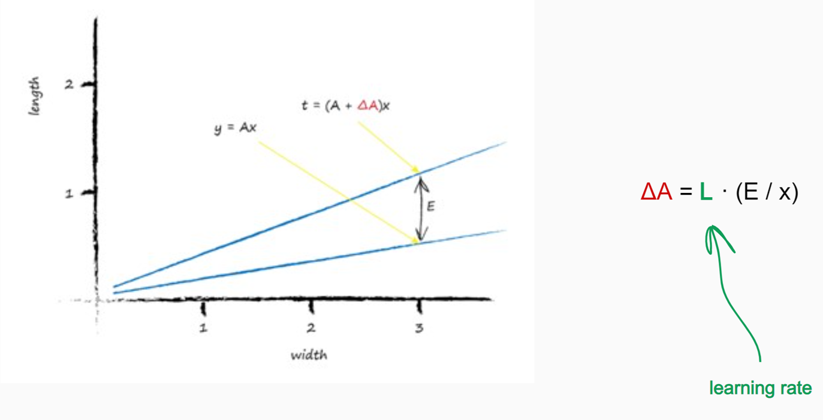
Calm down or moderate Learning Rate

Slide 19
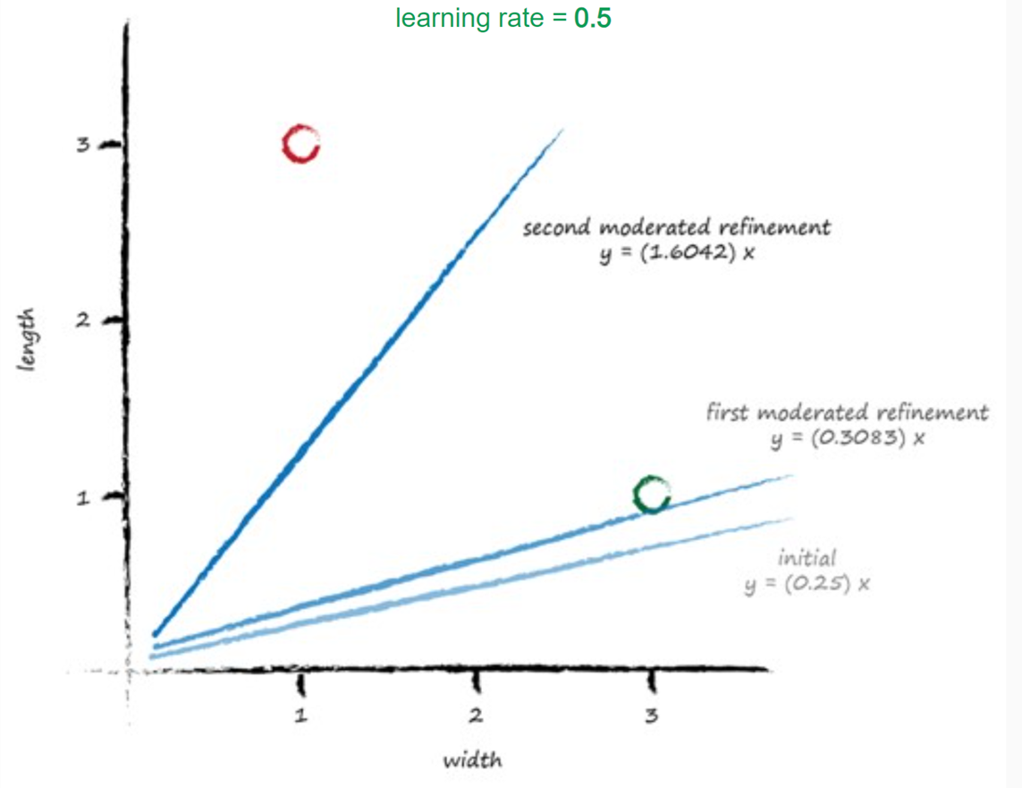
The Learning Rate
1) First training : y = 0.25 * 3.0 = 0.75. A desired value of 1.1 gives us an error of 0.35.
The Δ A = L ( E / x ) = 0.5 * 0.35 / 3.0 = 0.0583.
The updated A is 0.25 + 0.0583 = 0.3083.
x = 3.0 gives y = 0.3083 * 3.0 = 0.9250(below 1.1)
2) Second Example:
x = 1.0. Using A = 0.3083 → y = 0.3083 * 1.0 = 0.3083.
The desired value was 2.9 so the error is (2.9 - 0.3083)
= 2.5917.
Δ A = L ( E / x ) = 0.5 * 2.5917 / 1.0 = 1.2958. The even newer A is now 0.3083 + 1.2958 = 1.6042.
The dividing line is y=1.6042x, learned through an automated classification method
Moderating updates limits the impact of noisy or erroneous real-world training examples.

Slide 20
